Slide 1

Ansible Automation
Shreya Bhardwaj

Slide 2
Why do we need Automation?
What, Why and where?
What is automation- we all know- Automating a manual task
Why- to reduce time, effort and money
Where- Automation is everywhere these days. We are all a bit familier with the software automation tasks. I will be mainly talking about the IT automation- software as well as hardware.
Devops? Gitops?

Slide 3
INTRODUCTION
Ansible is a configuration management and provisioning tool.
What is a configuration management tool?
Configuration management is a process for maintaining computer systems, servers, and software in a desired, consistent state. It's a way to make sure that a system performs as it's expected to as changes are made over time.
Why do we need a configuration management tool?
Whenever a new server needs to be deployed, a configuration management tool can automate most of the provisioning process. Automation makes provisioning much quicker and more efficient because it allows tedious tasks to be performed faster and more accurately than any human could.

Slide 4
Benefits
So the benefits of using a tool for your configurations are many! To name a few:
Quick Provisioning of New Servers. For ex- a web server
No Snowflake Servers
Version Control for the Server Environment
Replicated Environments
Not dependent on type of OS running on the remote host

Slide 5
Characteristics of CM tool
Controller/manager and node/agent model.
Controller directs the configuration of the nodes, based on tasks defined in your provisioning scripts.
Automation Framework
Idempotent Behavior
System Facts
Templating System
Extensibility
Declarative in nature

Slide 6
Why Ansible?
We have a lot of automation tools available in the market like CHEF, ANISBLE, PUTTET, SALT etc
Why choose Ansible?
Ansible, doesn’t require installation of additional software on the nodes. No agent application installed on all nodes.
Low learning curve, easy descriptive language based on YAML.
More readable syntax.
Uses SSH, Minimal in nature.
Setup is easy.
Architecture includes only server and clients.

Slide 7
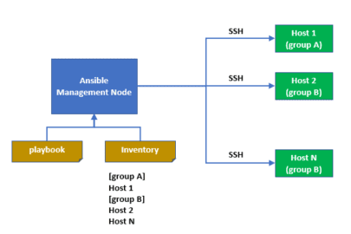
Architecture of Ansible
Control node
Managed nodes

Slide 8
Installation and setup
Ansible installation:
Using package manager : yum install ansible
Using pip: pip install ansible
Post installation: A directory is created /etc/ansible
We have our hosts file(inventory) here.
It is ini file.

Slide 9
Configuration of Ansible:
Inventory file example-
[groupA]
10.230.84.97
[groupB]
10.230.84.95
10.230.84.78
Cfg file- ansible.cfg
This is the configuration file of ansible where you can specify where your hosts file is located and give other specifications as well

Slide 10
Managing Servers
Ansible was designed to manage multiple servers from a single system by using SSH.
But first- setup and share ssh-keys from Ansible machine to all managed nodes.
Creating a ssh-key:
#ssh-keygen
Copying it to the servers:
# ssh-copy-id 10.230.84.86

Slide 11
DEMO

Slide 12

Modules
Modules are predefined functions in ansible which are used to perform some specific task. For example:
copy module
Package module
Service module
File module
Debug module
Archive module
Unarchive module
Lineinfile module
User module
Command module etc

Slide 13
Ad-hoc commands
Simplest way to use ansible.
A command-line tool which uses /usr/bin/ansible to run a single task on one or more managed nodes.
Syntax: ansible <hosts> [-m <module_name>] -a <"arguments"> -u <username> [--become]
Example: anisble groupA –m ping
Example: ansible groupB -m copy -a "src = /etc/yum.conf dest = /tmp/yum.conf”
Disadvantage: Cannot reuse the code.
Not documented.

Slide 14
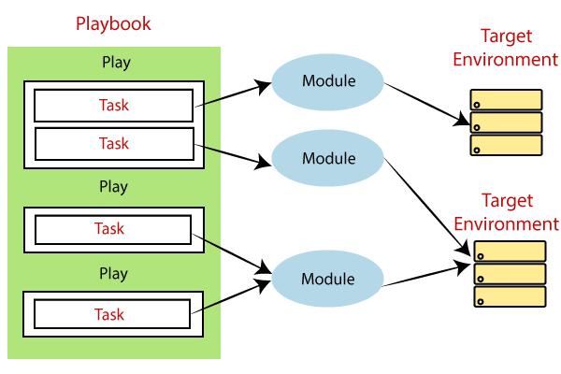
Playbooks
Written in YAML.
YAML is very sensitive to white-space, and uses that to group different pieces of information together.
Only spaces should be used. NO Tabs
Playbook can run multiple Tasks.
Example:
- hosts: groupB
tasks:
- name: installing httpd
package:
name: httpd
state: present

Slide 15
Why ansible for Hardware? Infrastructure as a code?
Lets assume a scenario of a data center, where we have 1000’s of physical DELL servers and 10000’s of DELL storage devices.
Can we even imagine the time it can take to configure the servers and storages?
A lot right!
That’s where automation tools like ansible come into the picture, which can reduce this time to literally minutes.
How? Lets dive into that.

Slide 16
Python? Shell script?
Declaractive
ideptotent

Slide 17
OpenManage Modules- Server Automation
In recent years, Infrastructure as Code (IaC) has gained widespread adoption with DevOps. IaC defines the configuration of compute, network and storage through source code that can be treated like any software. You can provision a dynamic infrastructure in a matter of seconds rather than days by simply running software commands.
It takes 72% less time and 33 fewer steps to configure a new server using OpenManage Ansible modules1 . This guarantees rapid deployment with a consistent and compliant infrastructure
Dell EMC OpenManage Ansible Modules allows IT administrators to use Ansible to automate and orchestrate the configuration, deployment, and update of Dell EMC PowerEdge Servers and modular infrastructure by leveraging the management automation capabilities in-built into the Integrated Dell Remote Access Controller (iDRAC), OpenManage Enterprise and OpenManage Enterprise Modular.

Slide 18
All tools

Slide 19
Key-Features
The key features in OpenManage Ansible Modules are: ● Support for updating firmware and managing storage volume configuration using standard Redfish URIs supported by iDRAC. ● Support for managing network, proxy, web server and time configurations. ● Support for creating, modifying or deleting single identity pool. ● Support for creating a firmware baseline or catalog. ● Retrieve baseline and baseline compliance details. ● Support for creating, modifying or deleting a user account. ● Perform the supported power state management operations on devices managed by OME. ● Support for creating, modifying, deploying, exporting, importing and cloning a template. ● Get the list and details of all user accounts or of a specific account. ● Get the list and details of templates or of a specific template. ● Support for firmware update of PowerEdge devices and all its components. ● Support for retrieving job details for a given job ID or the entire job queue. ● Support for retrieving the list of all devices with the exhaustive inventory of each device. ● Export a server configuration profile (SCP) containing either the entire server configuration or component level configuration (iDRAC, BIOS, RAID, NIC) to a local file path on Ansible controller or a remote network share. ● Import an SCP from a local file path on Ansible controller or a remote network share. ● Support for configuration of BIOS, Integrated Dell Remote Access Controller (iDRAC), NIC, and RAID. ● Support for firmware update using a firmware repository hosted on CIFS, NFS, HTTP, HTTPS, or FTP shares. ● Support for viewing firmware inventory details. ● Support for Windows, Linux, and ESXi operating system deployments. ● Support for configuring power controls, resetting iDRAC, viewing Lifecycle Controller (LC) job status, deleting LC job, deleting LC job queue, exporting LC logs, and configuring system lockdown mode. ● Retrieve the system inventory details.

Slide 20
How OpenManage Ansible Modules work with iDRAC
OpenManage Ansible modules uses iDRAC REST APIs based on Redfish standards and Server Configuration Profiles (SCP) for automated configuration, deployment and update of PowerEdge servers. An SCP contains all BIOS, iDRAC, Network and Storage settings of a PowerEdge server. You can apply them to multiple servers, enabling rapid, reliable, and reproducible configuration. You can perform an SCP operation using any of the following methods: ● Export to or import from a remote network share via CIFS, NFS. Ensure that the remote network share is mounted on the Ansible controller with read-write privileges for user running the Ansible playbooks. ● Export or import via local file streaming (for iDRAC firmware 2.60.60.60 and above). Setting up a local mount point for a remote network share Mount the remote network share (CIFS or NFS) locally on the Ansible controller where you want to run the playbook or modules. Local mount point should have read-write privileges in order for OpenManage Ansible modules to write an SCP file to remote network share that will be imported by iDRAC.

Slide 21
Install omsdk

Slide 22
DEMO of open manage modules

Slide 23
Ansible Modules for Dell EMC PowerMax
Similary, we have ansible modules to configure DELL storages as well
The Ansible Modules for Dell EMC PowerMax allow Data Center and IT administrators to use RedHat Ansible to automate and orchestrate the configuration and management of Dell EMC PowerMax arrays.
The capabilities of Ansible modules are managing volumes, storage groups, ports, port groups, hosts, host groups, masking views, snapshots, and gathering high-level facts about the arrays. The options available for each capability are list, show, create, delete, and modify. These tasks can be executed by running simple playbooks written in yaml syntax. The modules are written so that all the operations are idempotent, therefore making multiple identical requests has the same effect as making a single request.

Slide 24
modules
Volume module
Host module
Host group module
Snapshot module
Maskingview module
Port module
Port group module
Storage group module
Gather facts module
SRDF module
RDF module

Slide 25
Thank
You!
Q&A

